Slide 1


Mid Term Project – Group 8
Distributed and Scalable Data Engineering

Slide 2




TEAM MEMBERS
Sai Rekha Unnam
(Team Leader)
Harshith Reddy Pathpi
(Data Scientist)
Sai Chaitanya Kolli
(Data Modeling)
Manikanta Teja Babu Paritala (Data Visualization)

Slide 3


SENTIMENT ANALYSIS BRIEF OVERVIEW
Sentiment Analysis is the most common text classification tool that analyses an incoming message and tells whether the underlying sentiment is positive, negative and neutral

Slide 4
Understanding the Classification of Sentiment Analysis
Raw Statement | Sentiment
I don’t like the way of approach | Negative
I like the way they explain the video | Positive
The video is ok but not as expected | Neutral

Slide 5

What’s Our Project Aims To Achieve
As a YouTube channel grows, it gets a lot of comments from viewers. These comments are important for understanding viewer expectations and improving engagement. However, not all comments are useful.
Some have mistakes and are not well-written. It's hard for content creators to find the most relevant comments. This project helps categorize comments based on sentiment and sentence types to help YouTubers find useful feedback for growing their audience.

Slide 6
Project Plan to build Classifier Model
Collecting and Preprocessing of data
Sentiment Analysis
Error Detection and Correction
Categorization by Sentence Type
Filtering Poorly Constructed Comments and Presenting

Slide 7
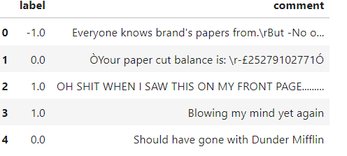
DATASET SAMPLE
We have taken the datasets from Kaggle.
Link: https://www.kaggle.com/datasets/kevinleekrus/youtube-videos-comments-analysis

Slide 8

MACHINE LEARNING MODELS
Multinomial Naive-Bayes Model
Logistic Regression
SVC (Support Vector Classifier)
Decision Tree
Random Forest

Slide 9
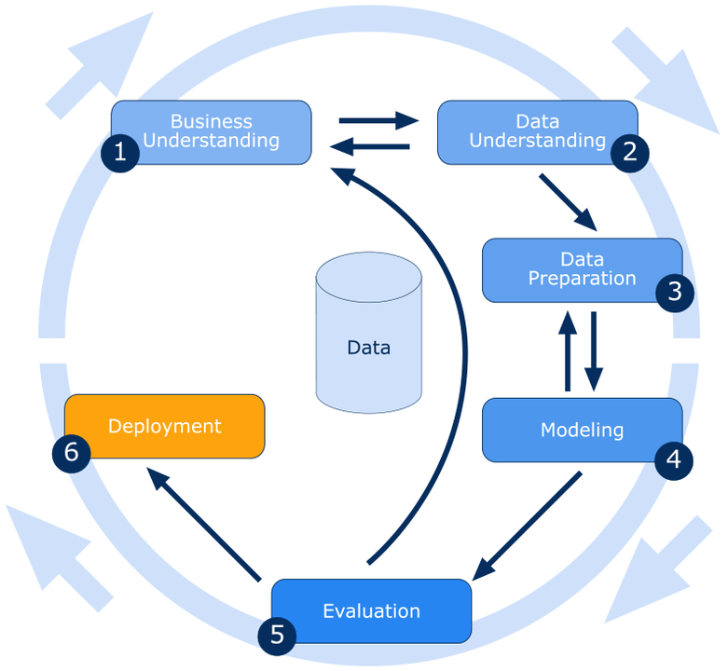
CRISP DM METHODOLOGY

Slide 10


